Slide 1
PropertySuggester
Wikidata.lib

Slide 2
Agenda
Development Process
Workflow
Evaluation
Future Plans

Slide 3

Demo

Slide 4





Development Process
Repository: Github
Feature-Branches
Pull requests
Reviews
Continuous Integration: Travis
Test coverage: Coveralls
Python: 83%
PHP: ?

Slide 5
Deployment
Complete Code Review by Wikimedia (end of March)
Build integration with wikibase
Stages
beta instance
test.wikidata.org
wikidata.org

Slide 6
PropertySuggester Workflow
XML/JSON Dump
Feature CSV
PHP Suggester
Suggestions
Dump parser
MySQL Table
Calculate Probabilities

Slide 7
Workflow
XML/JSON Dump
Feature CSV
PHP Suggester
Suggestions
Dump parser
MySQL Table
Calculate Probabilities
XML Dump (30GB)
Contains all Wikidata pages and JSON data in the <text> tag
Convert to CSV
XML Stream Parser (xml.etree.cElementTree)
40minutes
CSV (1.2GB)
Q1,31,wikibase-entityid,Q223557
Entity: Q1 (Universe)
Property: 31 (instance of)
Property Type: wikibase-entityid
Value: Q223557 (Physical Object)
Notes:
Vorher 25 / 0.8

Slide 8
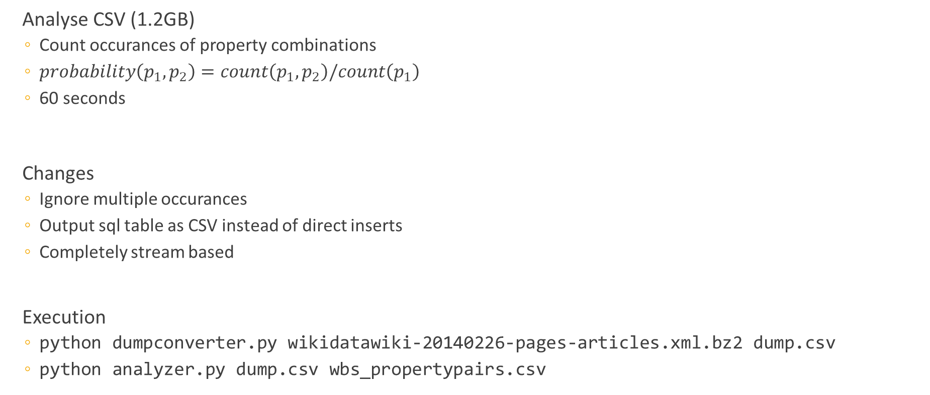
Workflow
XML/JSON Dump
Feature CSV
PHP Suggester
Suggestions
Dump parser
MySQL Table
Calculate Probabilities
Analyse CSV (1.2GB)
Count occurances of property combinations
$probability\left(p_{1},p_{2}\right)=count\left(p_{1},p_{2}\right)/count\left(p_{1}\right)$
60 seconds
Changes
Ignore multiple occurances
Output sql table as CSV instead of direct inserts
Completely stream based
Execution
python dumpconverter.py wikidatawiki-20140226-pages-articles.xml.bz2 dump.csv
python analyzer.py dump.csv wbs_propertypairs.csv

Slide 9
Workflow
XML/JSON Dump
Feature CSV
PHP Suggester
Suggestions
Dump parser
MySQL Table
Calculate Correlations
MySQL Table
propertyPairs(pid1 INT, pid2 INT, probability FLOAT)
Provide Suggestions
Example: Entity mit InstanceOf (P31) und Geburtsdatum (P569)
SELECT pid2, sum(probability)/2 AS prob FROM propertyPairs WHERE pid1 IN (31, 569) AND pid2 NOT IN (31, 569, 107) GROUP BY pid2 HAVING sum(probability)/2 > $threshold ORDER BY prob DESC LIMIT $limit
Notes:
107 : deprecated haupttyp
21 : Geschlecht
19 : Geburtsort

Slide 10
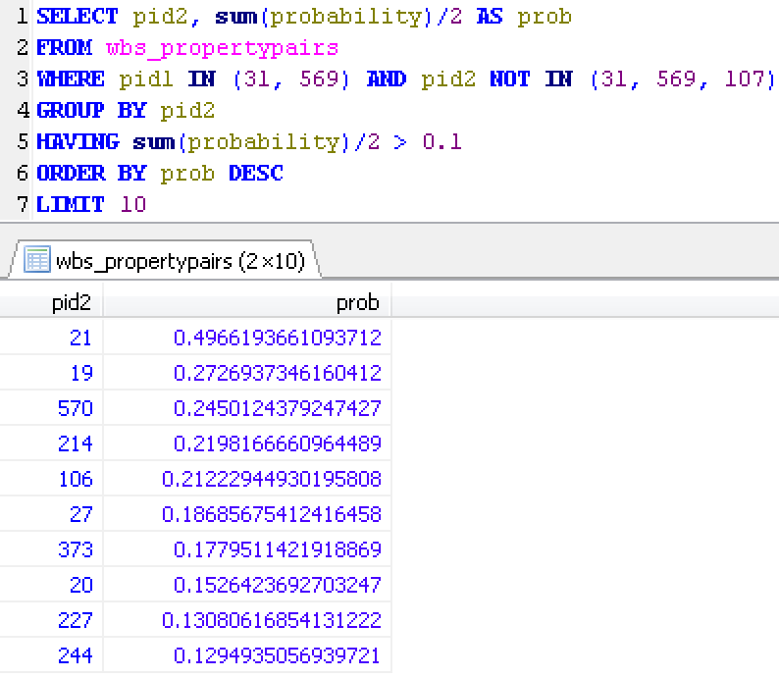
Workflow
XML/JSON Dump
Feature CSV
PHP Suggester
Suggestions
Dump parser
MySQL Table
Calculate Correlations
Notes:
107 : deprecated haupttyp
21 : Geschlecht
19 : Geburtsort

Slide 11





Import from CSV File
• Maintenance Script for importing property pair probabilities from CSV to DB
COPY
.csv
LOAD DATA INFILE
DBMS
INSERT…
• UnitTests → Travis: Test execution for MySQL and SQLite setup

Slide 12
Rank Properties for a Given Property Set
 | 1 | 2 | 3 | 4 | 5 | 6 | 7 | 8 | 9 | 10 | 11
1 | / | 0.2 | 0.4 | / | 0.1 | / |  | 0.3 | / |  | 0.6
2
3
4 | / | 0.4 | 0.5 | / | 0.7 | / | 0.1 | 0.4 | / |  | 0.5
5
6 | / | 0.8 | 0.9 | / | 0.1 | / | 0.1 | 0.4 | / |  | 0.1
7
8
9 | / | 0.5 | 0.1 | / | 0.2 | / | 0.9 | 0.7 | / |  | 0.1
10
11
S = {1,4,6,9}
This is how we rank suggestions!
+
+
+
+
+
+
Probability Sum for Property_{Column}
/ #S = normalized Probability [0,1]

Slide 13
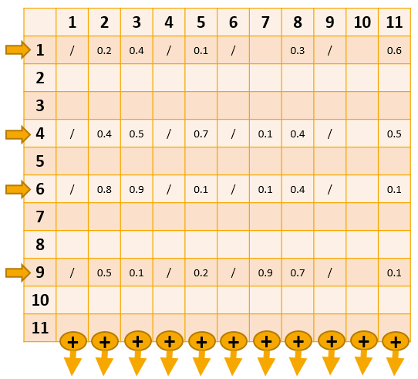
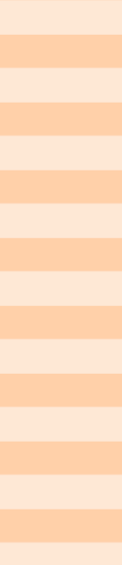
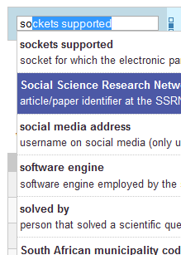
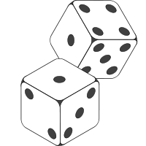
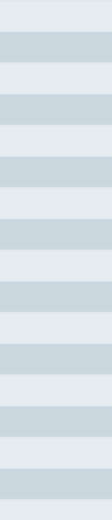
Combine Search Results
• Provide stability (e.g. new properties wouldn’t appear in suggestions…)
• Complex because of paging (offset, limit)
get suggestions
apply search
enough suggestions for
given offset & limit?
yes
our
suggestions
no
eliminate duplicates &
append to suggestions
former
search
results
get results
(search already applied)

Slide 14
Php Unit-Tests
→ MediaWikiTestCase
clones DB schema (tablenames with prefix)
Implement setUp(), addDBData(), tearDown(), testSomeFunctionality()
Test suggester
Insert sample property pair probability table
Request suggestions based on that table
Check if suggestions are as expected
Test maintenance csv import
Create sample csv file
Run import script
Check if table has all entries
assertEquals( 3, $suggestions->first()->getPropertyId() );
…
assertEquals( 5, sql(“SELECT COUNT(*) FROM propertypairs”) );
…

Slide 15
Evaluation

Slide 16
Evaluation
Algorithm
Choose a certain amount of properties randomly
Remove the last added property
Get suggestions for the Item
Rank : position of missing property in suggestions
Evaluator
Input: preprocessed Wikidata csv dump
Output: amount per rank
Visualisation: d3.js

Slide 17
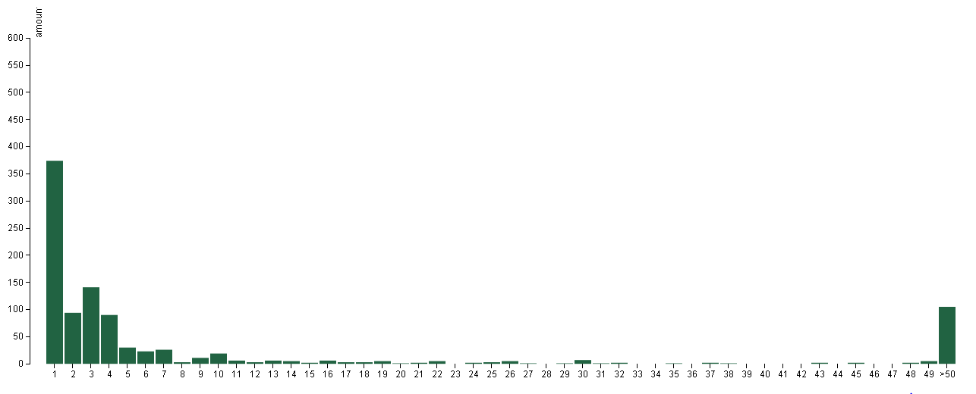
Results

Slide 18
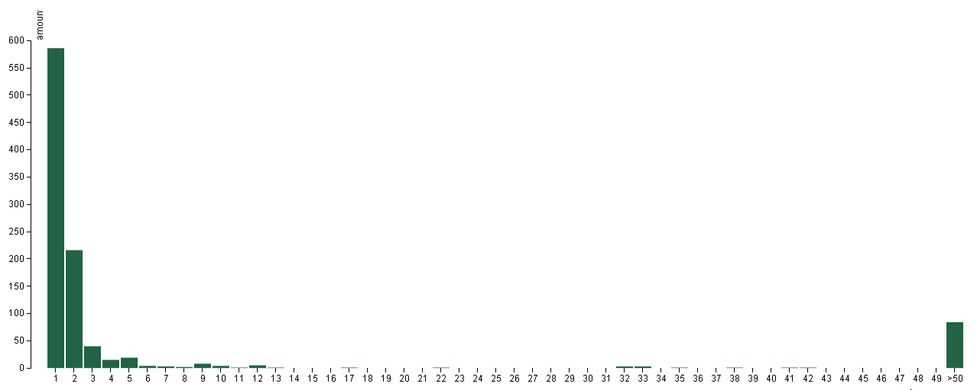
First letter evaluation
Extended algorithm:
Provide first letter of missing property as search parameter for suggester
Use Case: User is starting to type

Slide 19
data
Output:
CSV File
Amount per rank
Input: CSV File (836MB) preprocessed Wikidata csv dump Total amount of items in dump: 6656575
Q15,31,wikibase-entityid,Q5107 Q15,47,wikibase-entityid,Q48 Q15,361,wikibase-entityid,Q2 Q15,47,wikibase-entityid,Q46 Q15,373,string,Africa Q15,18,string,Africa satellite orthographic.jpg Q15,242,string,Africa ethnic groups 1996.jpg Q15,242,string,Afriko-meza.png Q15,625,globecoordinate,N7.188056, E21.093611 Q15,910,wikibase-entityid,Q5460710
…
rank,amount
1,374
2,94
3,141
4,90
5,30
6,23
7,26
8,3
9,11
10,19
…

Slide 20


Implementation
Evaluator
Python
Hierachical structure to easily extend existing implementation
Visualization
d3.js
bar chart
Processes csv file

Slide 21

Evaluation
User feedback to determine relevance (options)
User ranks suggestions to not relevant and relevant
Creating a website for feedback
Crowdsourcing
Internal in team
Further calculation
A = relevant set of information
B = retrieved set of information
Precision : $\frac{\left|A∩B\right|}{\left|A\right|}$
Recall : $\frac{\left|A∩B\right|}{\left|B\right|}$

Slide 22
Future plans

Slide 23
Editier/TODO Listen (Moritz)
- Misfits – prove of example use case/ what can be done with our api
Mögliche Zukunftspläne (Moritz)
- Ranking Adjustment
Classifier (Moritz)
- TFIDF – relevance word in a document vs relevance of suggestion/property for class
- aktuelles überarbeiten

Slide 24
Edit lists
Suggester API module can be queried to automatically create customized Edit lists
important use case:
User interested in specific properties (maybe an expert)
Existing solution in form of Python Script:
Input: List of properties
Goes through items in wikidata (offset/limit can be choosen)
For every item:
Scans suggestions returned by API based on existing properties
Adds item to Edit list, if it is likely missing one (or more) of the specified properties
Notes:
Screenshot/demo #Also possible: Misfit lists
(offsets, limit can be choosen)
Threshold for likely

Slide 25
Classifiers
Why classifiers?
Items in the same class often have similiar sets of properties
Classifier-Value-Pairs useful for finding appropriate suggestions
Great suggestions for items without existing properties
Generating suggestions based on classifiers is analog to what is done now
Ideas on identifying useful/good classifiers:
They should be used frequently -> good guess if no other information is available
Their values are items (classes represented by an item in wikidata)
It should be possible to derive relevant property suggestions from Classifier-Value-Pairs
Notes:
Classifiers = attribut that connect an item to a class
Great suggestions for items without preexisting properties –why!!
Only care about frequently used -> good guess if no other information is available

Slide 26
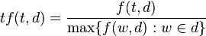
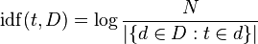

TF IDF
Measure originally used to reflect relevance of term t to a document d in a collection of documents D:
Same idea can be applied in order to rate the relevance of a property to a class:
Term -> property
Document -> class / all items with a specific classifier value pairs
Collection -> all items with a certain classifier
Term Frequency (tf)-> occurences of property in class divided by number of items in class
Inverse Document Frequency (idf) -> number of classes divided by number of classes with examined property
Notes:
Since the ratio inside the idf's log function is always greater than or equal to 1, the value of idf (and tf-idf) is greater than or equal to 0.
As a term appears in more documents, the ratio inside the logarithm approaches 1, bringing the idf and tf-idf closer to 0 (log(1)=0)
most occurences of any property in this class (per definition the cassifier->every item in the class has it) -> divide by number of items in class

Slide 27
Algorithm for finding Classifiers
Only consider properties with datatype item
Find the 10 most frequently used properties
Rate every property p as follows:
Find the 10 most frequent values for p (most common classes)
For every class do:
find the 7 properties with the highest tf idf rating regarding this class
compute average rating
Compute the overall average as the rating for p
Satisfying results when used on the current dump -> Top rated classifiers: instanceOf & occupation
Notes:
Algorithm for generating suggestions based on classifiers IS very similiar to our general approach:
->Now one extra table for each classifier with one row for each classifier-value-combination
Percentage thresholds and number of properties/classes can/could be adjusted
Examples during explanation: sex vs instanceOf
Explain houghts behind each step of algorithm!

Slide 28
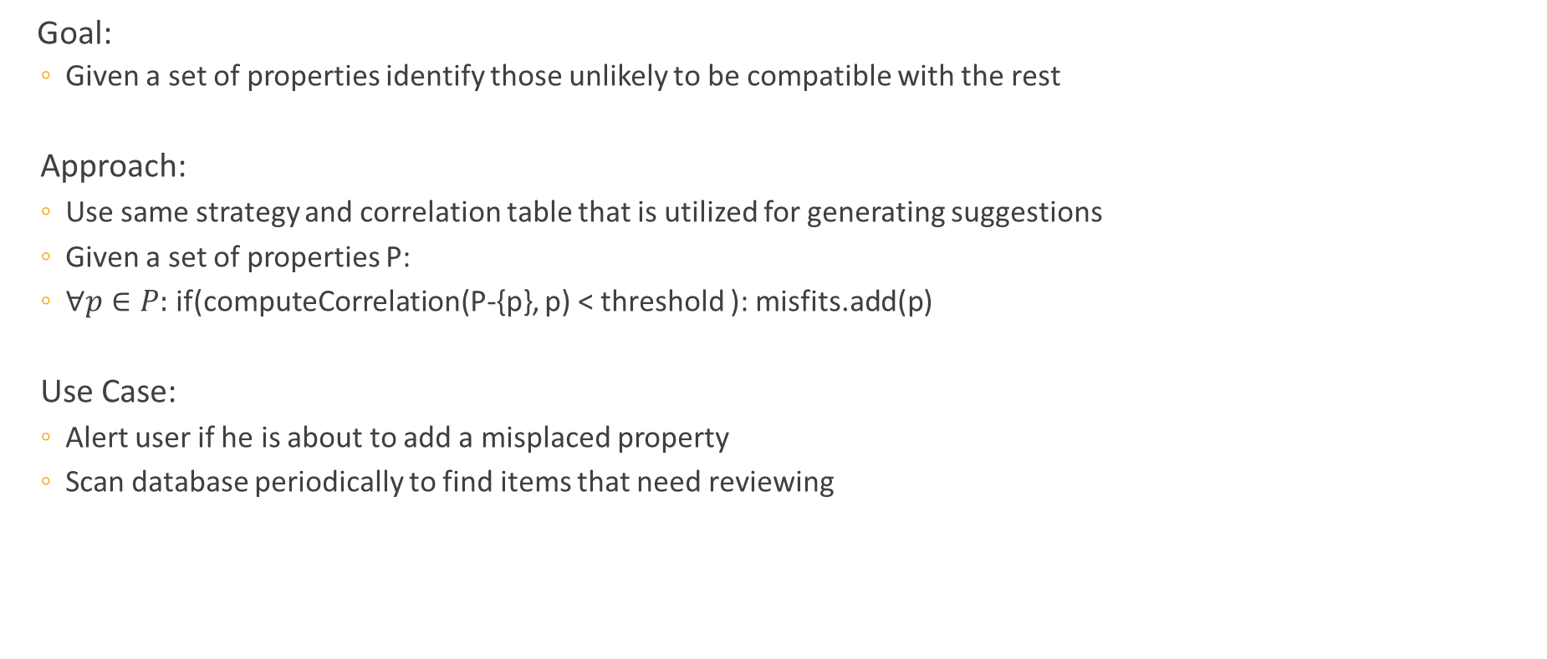
Finding “Misfits“
Goal:
Given a set of properties identify those unlikely to be compatible with the rest
Approach:
Use same strategy and correlation table that is utilized for generating suggestions
Given a set of properties P:
$∀p∈P:$ if(computeCorrelation(P-{p}, p) < threshold ): misfits.add(p)
Use Case:
Alert user if he is about to add a misplaced property
Scan database periodically to find items that need reviewing
Notes:
Beispiel: Mensch hat idR keinen Staat sondern eine Staatsbürgerschaft etc…
Scan part of database
Offenheit von wikidata erklären, user darf nichts verboten bekommen!

Slide 29
Adjust Property Ranking
Motivated by possible use cases:
Downgrade rank of identifiers (mostly filled in by bots)
Strategy
Maintain extra column “adjustment value“ in table properties
Update by analysing wikidata dumps, user feedback etc.
Join “propertyValuePairs“ with “properties“ during ranking process

Slide 30
Finding Examples / Representatives
Finding good representatives for classes:
Items with most properties
Items most edits (and other meta information)
When an item is being edited:
Use classifier information or other metric to find similiar items (items in the same class)
Identify good representatives for the current item‘s class
Support edit process by providing user with examples from these items
Notes:
Todo: Grafic

Slide 31


